Slide 1
Study Group
#1: Intro :)
Speaker: Lindy Zhai, Mindy Lee
University of Toronto Machine Intelligence Team

Slide 2

Coursera;
https://www.coursera.org/programs/coursera-for-university-of-toronto-ql0lg?currentTab=CATALOG
Notes:
In short, machine learning is AI that can automatically adapt with minimal human interference.

Slide 3
What to expect?
A lotta fun! (check syllabus)
Quizzes (Q&A)
General Q&A sessions
Maybe assignments? (You request it, we do it!)
Fun projects collaborations with the project workshops
Notes:
This is the first session so we will take it easy and go through some details regarding the curriculums and what is coming next. But I can assure you the following sessions are going to be far more interesting and you can expect a lot of extra fun details that was not included in the lectures.

Slide 4
Deep Learning;
Machine Learning:
AI that automatically adapt with minimal human interface.
Then what’s deep learning?
Neural Networks
Notes:
In short, machine learning is AI that can automatically adapt with minimal human interference.

Slide 5
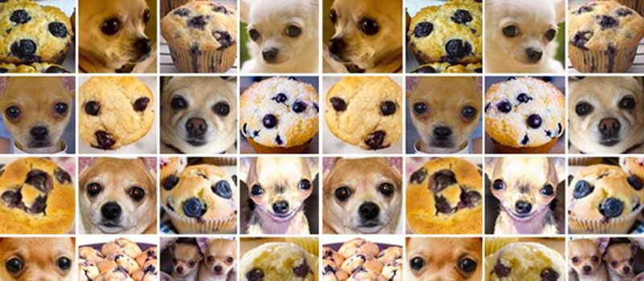
Example of deep learning projects;
https://github.com/ieee8023/deep-learning-datasets/tree/master/chihuahua-muffin
Notes:
This is the first session so we will take it easy and go through some details regarding the curriculums and what is coming next. But I can assure you the following sessions are going to be far more interesting and you can expect a lot of extra fun details that was not included in the lectures.

Slide 6
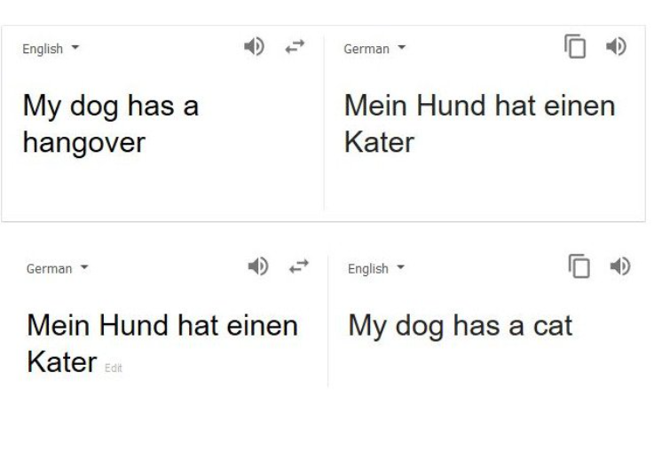
Example of deep learning projects;
Notes:
Recurrent network

Slide 7
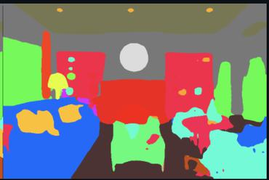
Example of deep learning projects;
https://paperswithcode.com/task/semantic-segmentation
Notes:
This is the first session so we will take it easy and go through some details regarding the curriculums and what is coming next. But I can assure you the following sessions are going to be far more interesting and you can expect a lot of extra fun details that was not included in the lectures.

Slide 8

Example of deep learning projects;
https://www.artbreeder.com/
Notes:
This is the first session so we will take it easy and go through some details regarding the curriculums and what is coming next. But I can assure you the following sessions are going to be far more interesting and you can expect a lot of extra fun details that was not included in the lectures.

Slide 9
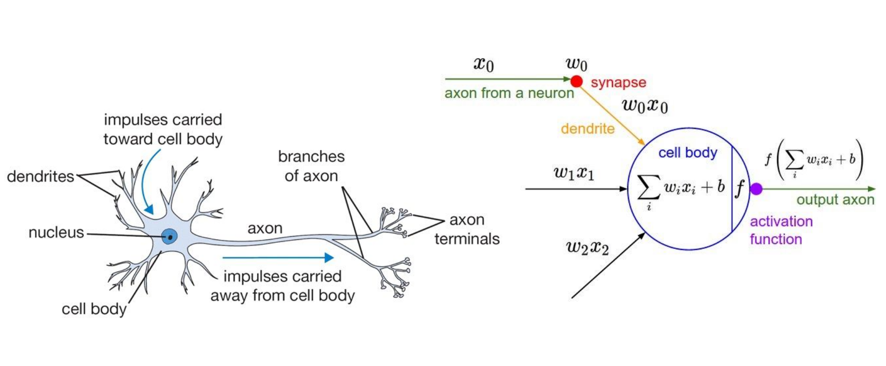
Neurons (perceptrons)
Notes:
This is the first session so we will take it easy and go through some details regarding the curriculums and what is coming next. But I can assure you the following sessions are going to be far more interesting and you can expect a lot of extra fun details that was not included in the lectures.

Slide 10
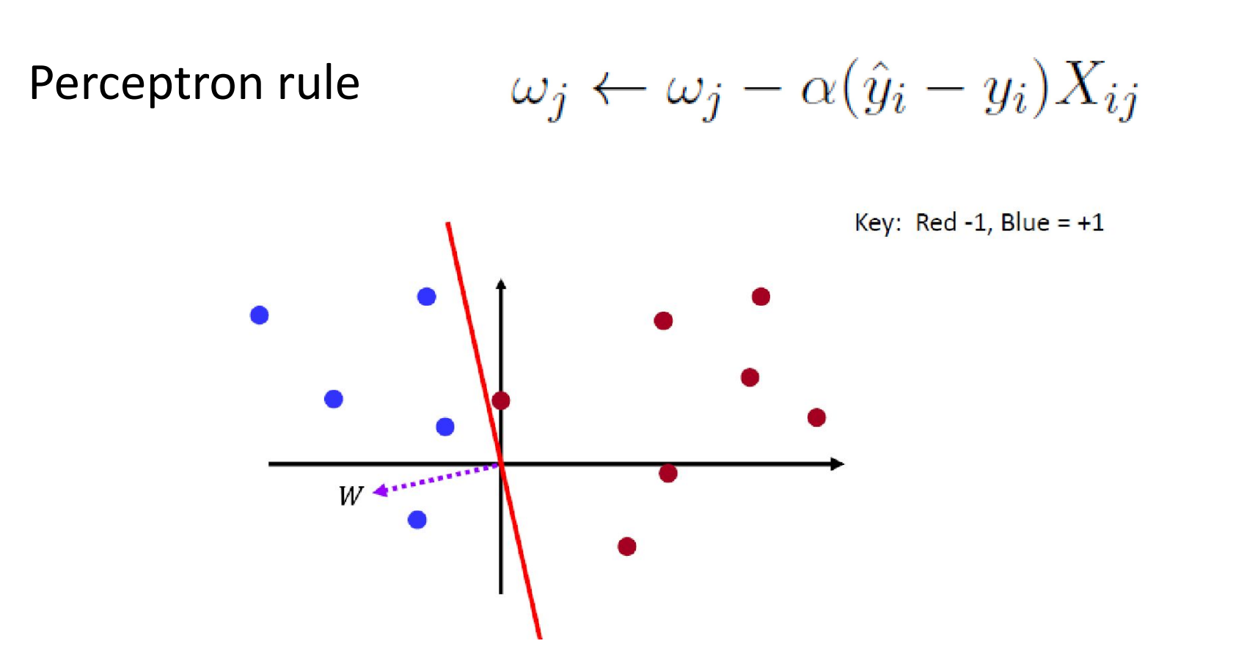
Weight Update;
Notes:
This is the first session so we will take it easy and go through some details regarding the curriculums and what is coming next. But I can assure you the following sessions are going to be far more interesting and you can expect a lot of extra fun details that was not included in the lectures.

Slide 11
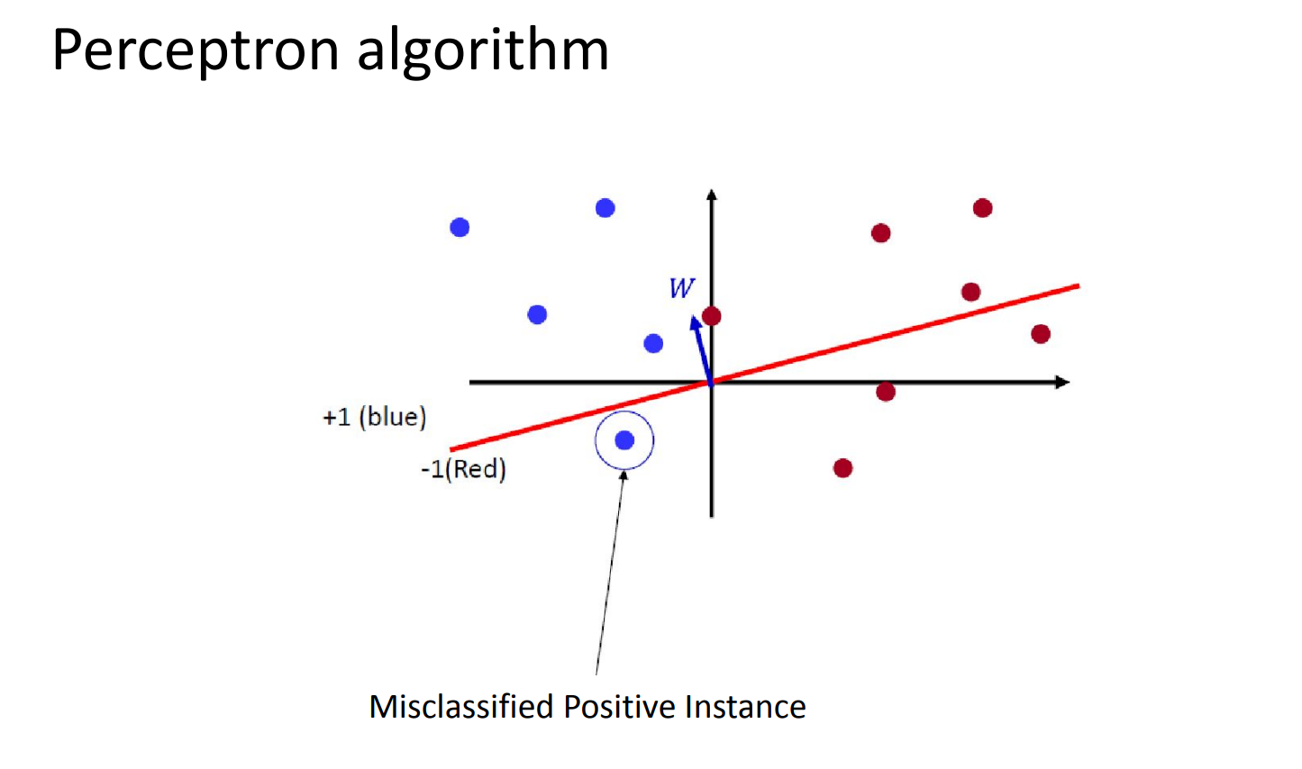
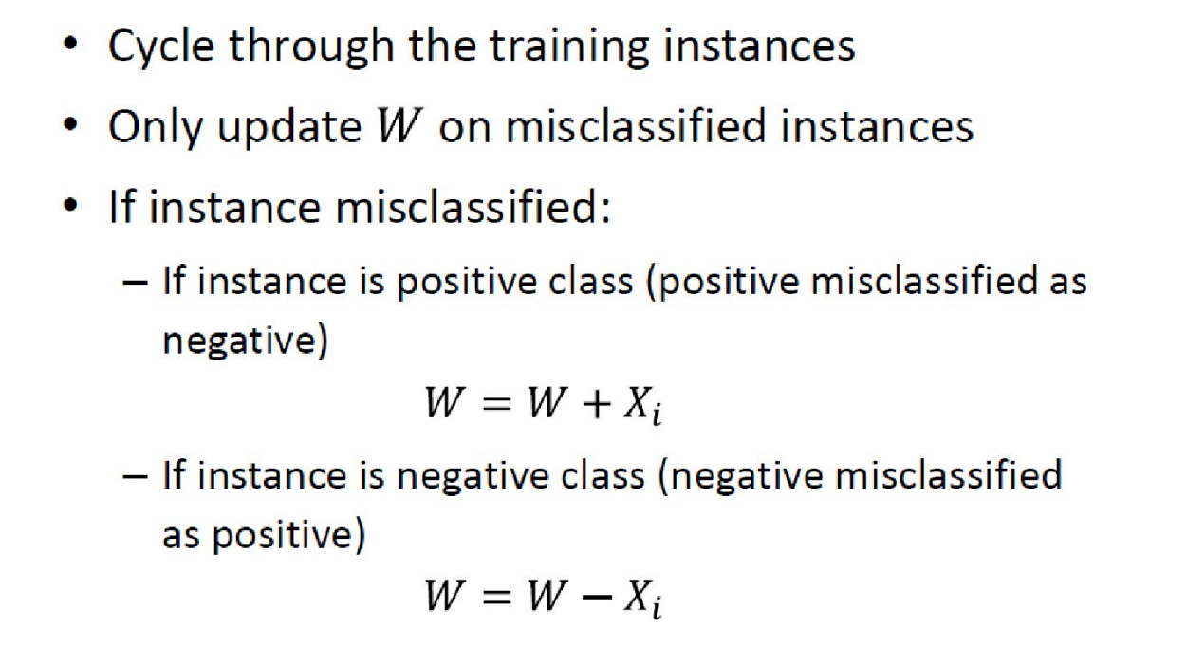
Weight Update;
Notes:
This is the first session so we will take it easy and go through some details regarding the curriculums and what is coming next. But I can assure you the following sessions are going to be far more interesting and you can expect a lot of extra fun details that was not included in the lectures.

Slide 12
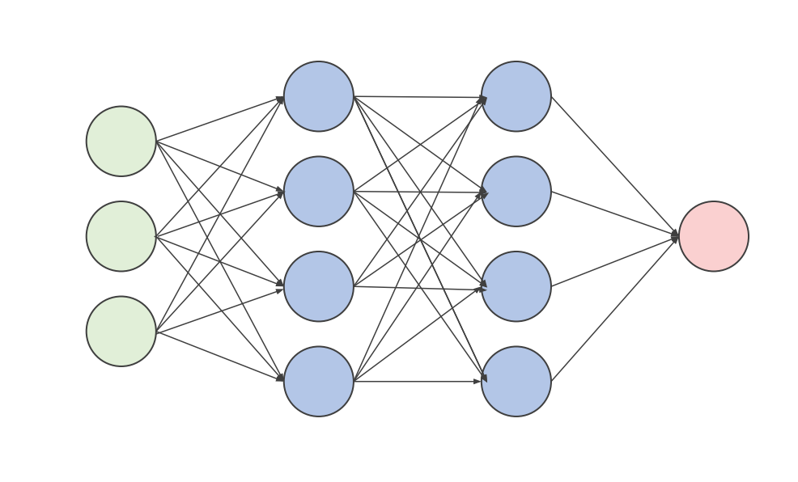
Perceptrons;
Notes:
To deal with the linearly inseparable cases

Slide 13
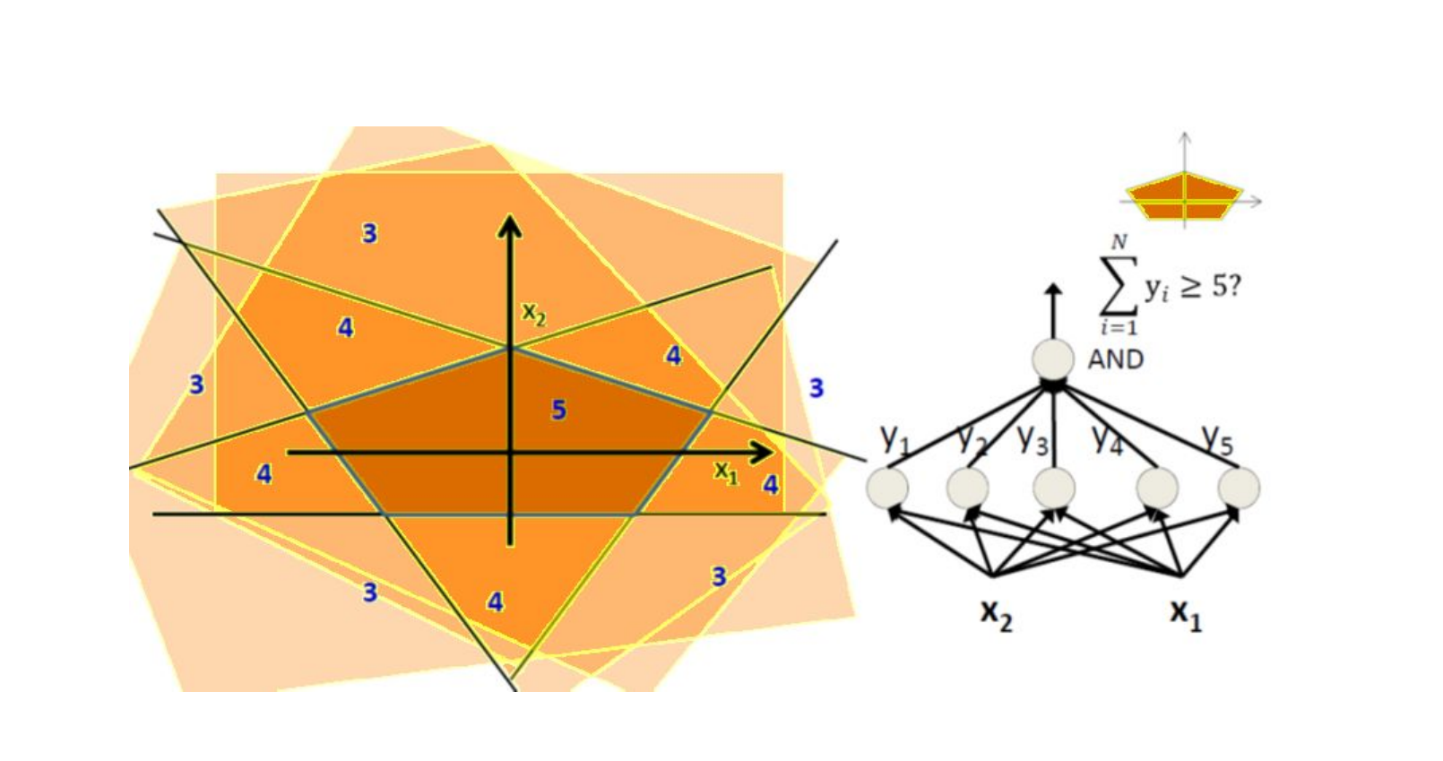
Perceptrons;
Notes:
To deal with the linearly inseparable cases

Slide 14
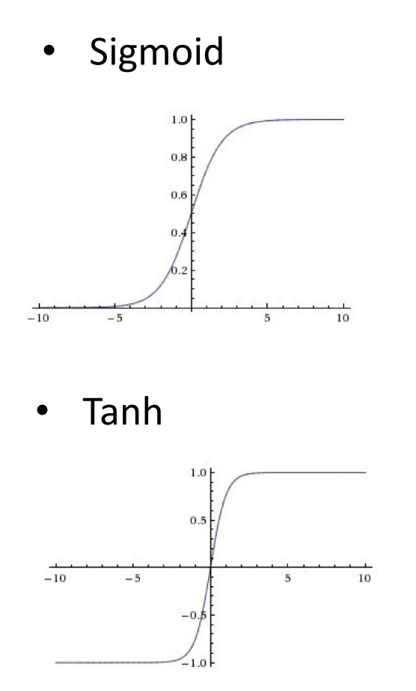
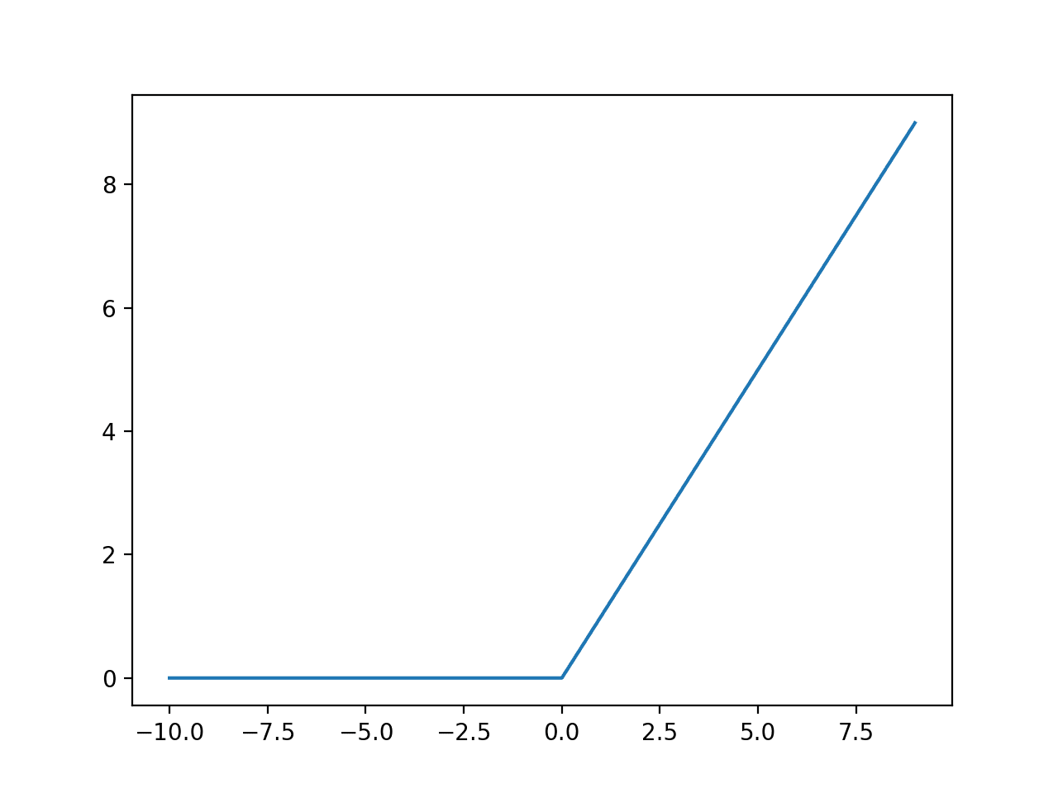
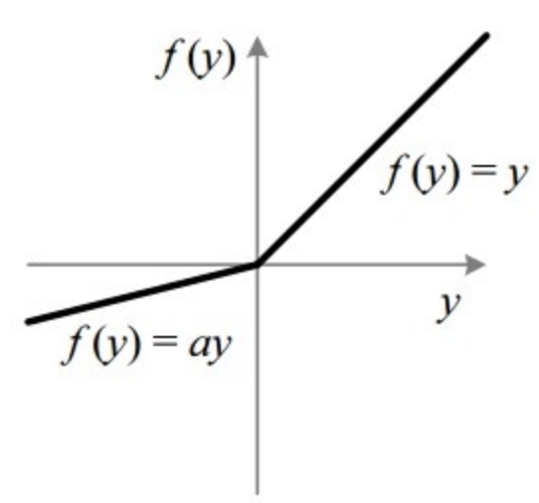
Activation Function;
Relu
Leaky-Relu
Notes:
Rectified Linear Unit

Slide 15
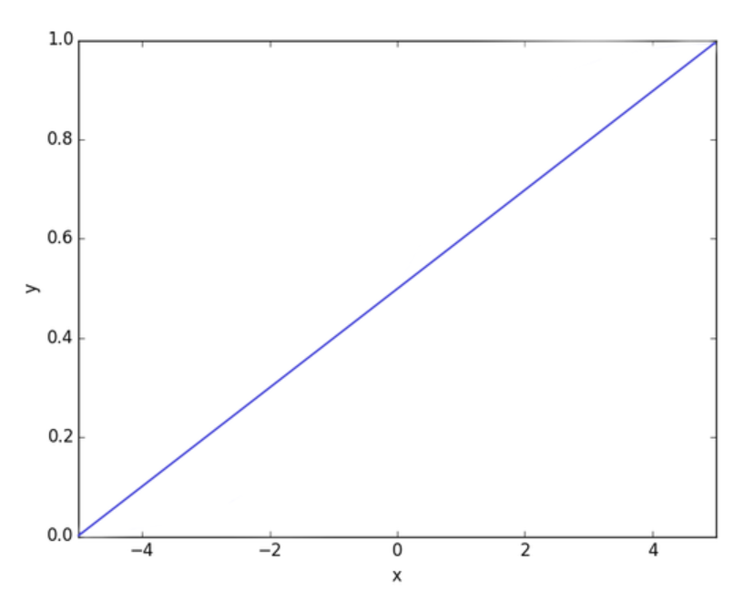
Activation Function;
Notes:
This is the first session so we will take it easy and go through some details regarding the curriculums and what is coming next. But I can assure you the following sessions are going to be far more interesting and you can expect a lot of extra fun details that was not included in the lectures.

Slide 16
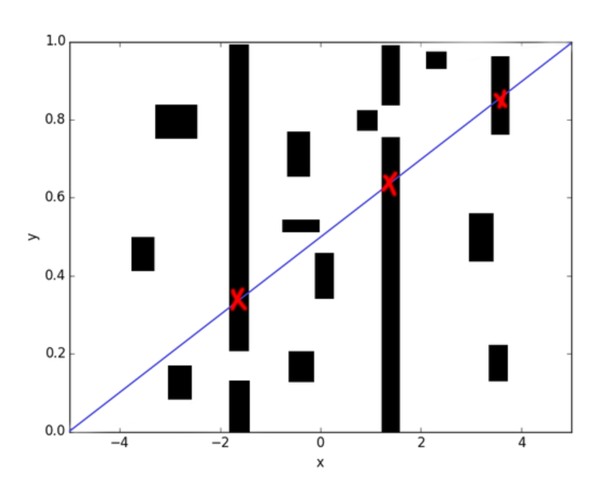
Activation Function;
Notes:
This is the first session so we will take it easy and go through some details regarding the curriculums and what is coming next. But I can assure you the following sessions are going to be far more interesting and you can expect a lot of extra fun details that was not included in the lectures.

Slide 17
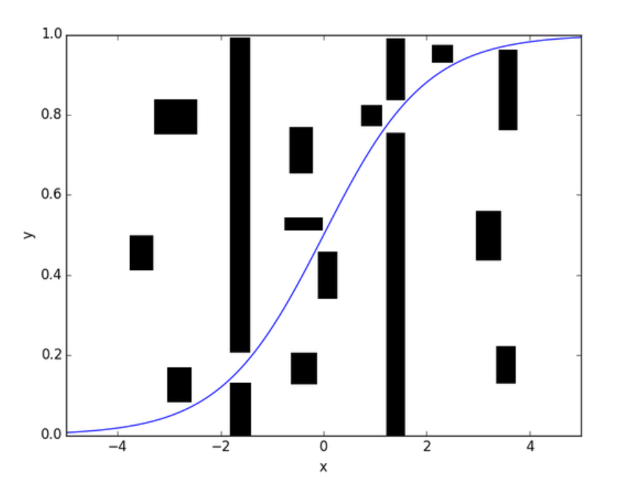
Activation Function;
Notes:
This is the first session so we will take it easy and go through some details regarding the curriculums and what is coming next. But I can assure you the following sessions are going to be far more interesting and you can expect a lot of extra fun details that was not included in the lectures.

Slide 18
Quiz!
Notes:
This is the first session so we will take it easy and go through some details regarding the curriculums and what is coming next. But I can assure you the following sessions are going to be far more interesting and you can expect a lot of extra fun details that was not included in the lectures.

Slide 19
Jk no Quiz.
Notes:
This is the first session so we will take it easy and go through some details regarding the curriculums and what is coming next. But I can assure you the following sessions are going to be far more interesting and you can expect a lot of extra fun details that was not included in the lectures.

Slide 20
yes Quiz!
Notes:
This is the first session so we will take it easy and go through some details regarding the curriculums and what is coming next. But I can assure you the following sessions are going to be far more interesting and you can expect a lot of extra fun details that was not included in the lectures.

Slide 21
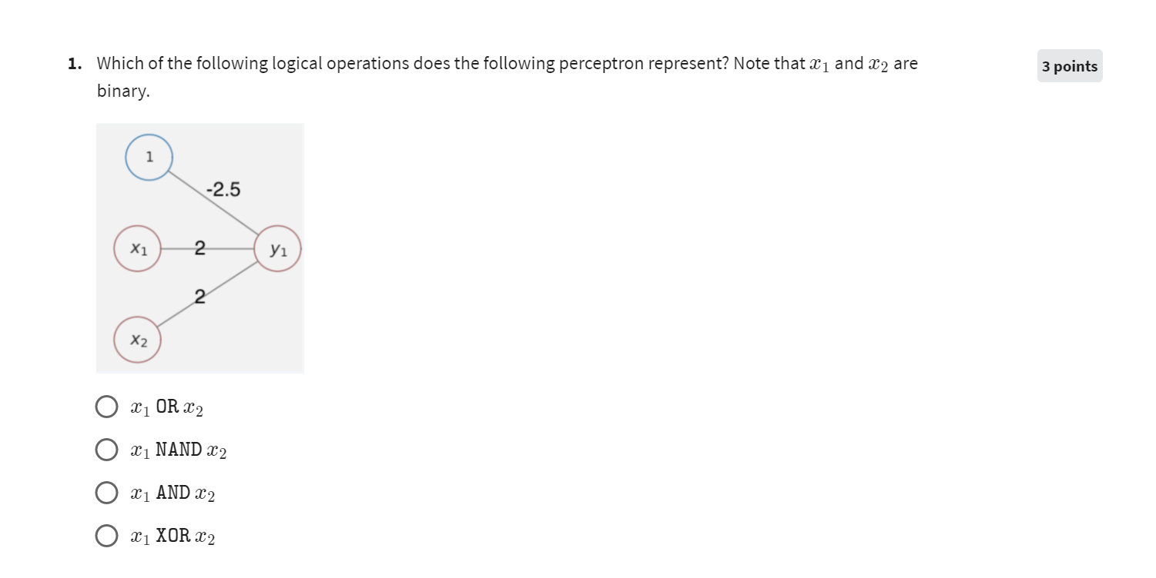
Quiz #1;
Notes:
This is the first session so we will take it easy and go through some details regarding the curriculums and what is coming next. But I can assure you the following sessions are going to be far more interesting and you can expect a lot of extra fun details that was not included in the lectures.

Slide 22
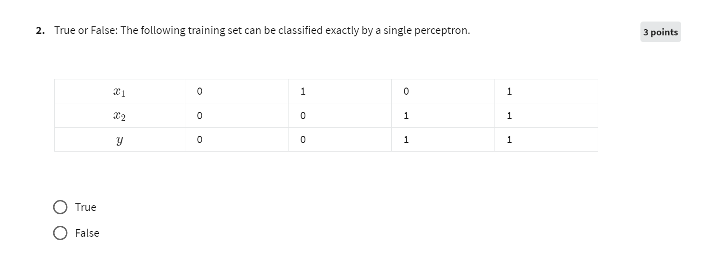
Quiz #1;
Notes:
This is the first session so we will take it easy and go through some details regarding the curriculums and what is coming next. But I can assure you the following sessions are going to be far more interesting and you can expect a lot of extra fun details that was not included in the lectures.

Slide 23
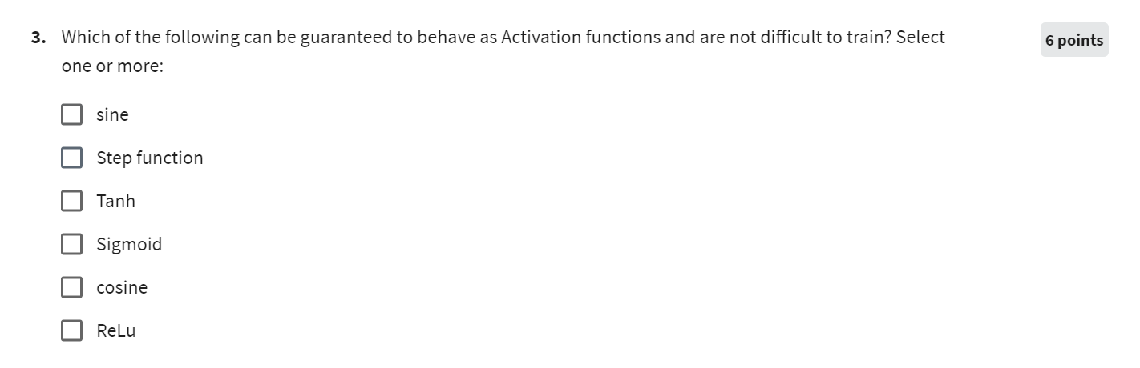
Quiz #1;
Notes:
This is the first session so we will take it easy and go through some details regarding the curriculums and what is coming next. But I can assure you the following sessions are going to be far more interesting and you can expect a lot of extra fun details that was not included in the lectures.

Slide 24
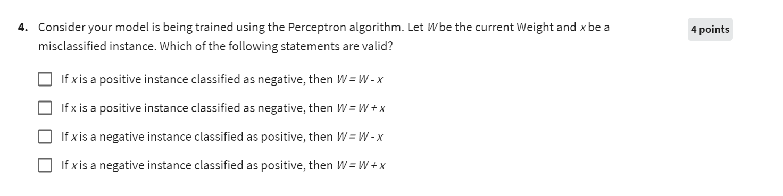
Quiz #1;
Notes:
This is the first session so we will take it easy and go through some details regarding the curriculums and what is coming next. But I can assure you the following sessions are going to be far more interesting and you can expect a lot of extra fun details that was not included in the lectures.

Slide 25
Quiz #1;
Notes:
This is the first session so we will take it easy and go through some details regarding the curriculums and what is coming next. But I can assure you the following sessions are going to be far more interesting and you can expect a lot of extra fun details that was not included in the lectures.

Slide 26
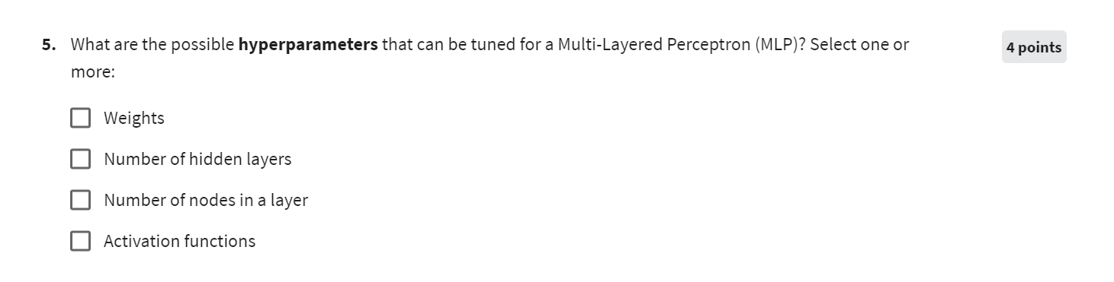
Quiz #1;
Notes:
This is the first session so we will take it easy and go through some details regarding the curriculums and what is coming next. But I can assure you the following sessions are going to be far more interesting and you can expect a lot of extra fun details that was not included in the lectures.

Slide 27
Next Session;
Loss functions
Backpropagation & Delta Rule (math!)
Lots of example
Optimization intro (make your “machine” learn)
Notes:
This is the first session so we will take it easy and go through some details regarding the curriculums and what is coming next. But I can assure you the following sessions are going to be far more interesting and you can expect a lot of extra fun details that was not included in the lectures.

